Slide 1

Physics-Inspired Distributed Radio Map Estimation
Dong Yang, Yue Wang
Computer Science
Georgia State University, Atlanta, GA, USA
Jan 17, 2025

Slide 2
Outline
Background
Problem formulation
State-of-the-art methods
Our method
Next plan

Slide 3
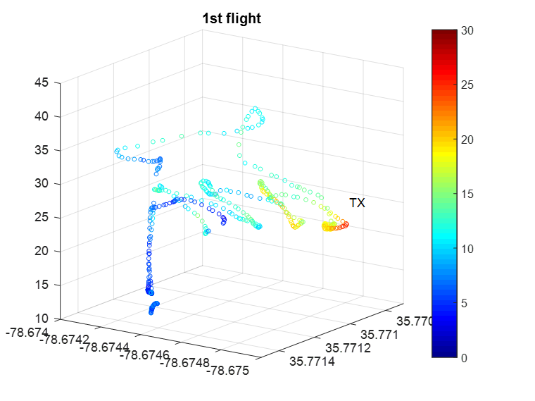
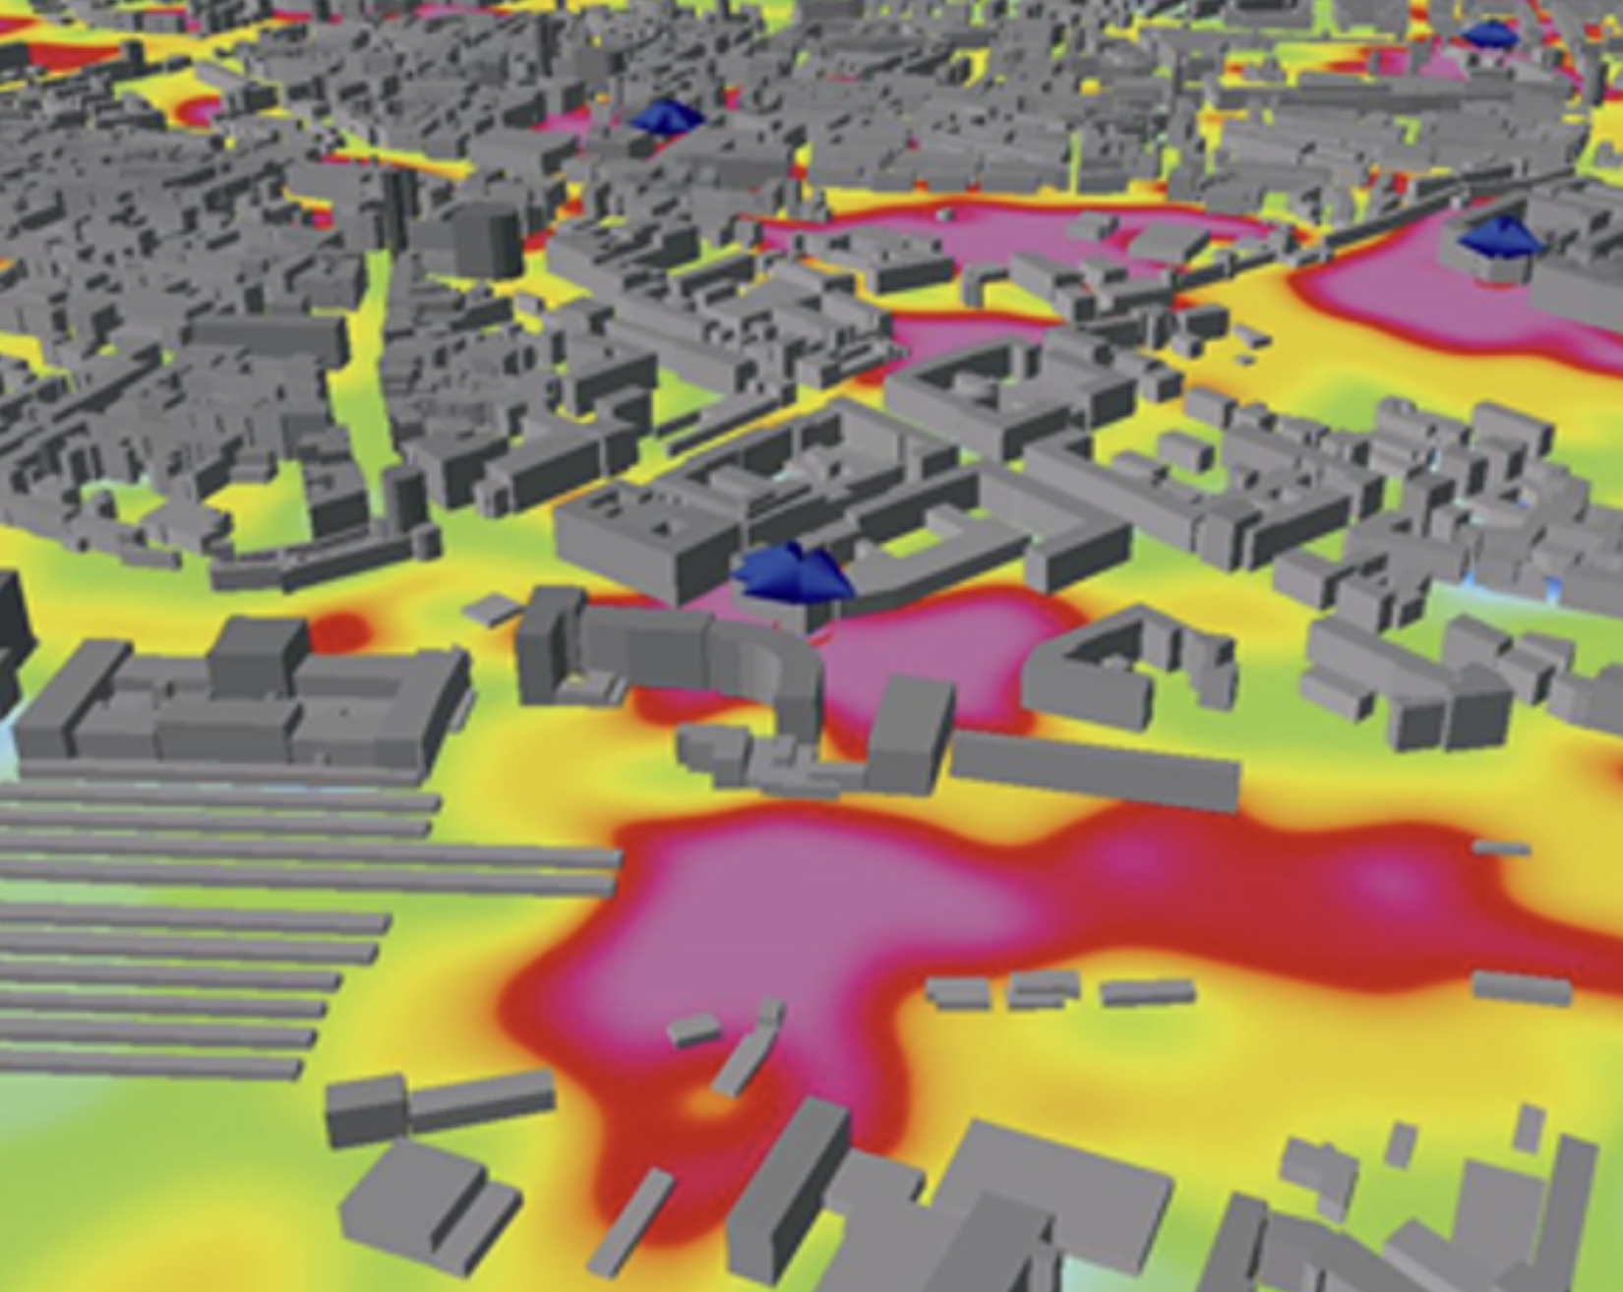
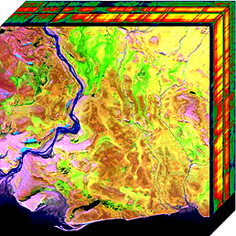
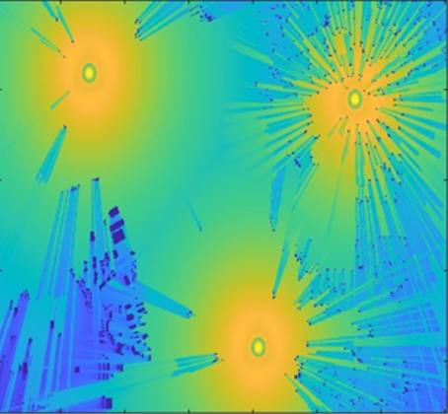
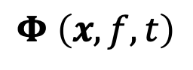
What is radio map
Radio map: radio power as a function of location x, frequency 𝑓 and/or with time 𝑡 denoted by
$$Φ \left(x,f,t\right)$$
2-D Spatial Space
3-D Spatial Space
Frequency
Time Slots
Radiomap: https://web.altair.com/winprop-telecom
2-D Spatial Space
2-D Spatial Space
useful for downstream tasks: network management, coverage planning, spectrum allocation
Notes:
Network management: detect signal blind or interference and take remedial action
Spectrum allocation: Identify interference areas in the radio frequency band to avoid frequency conflict or overlap

Slide 4
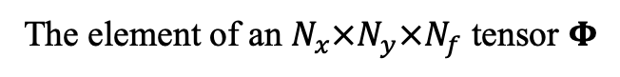

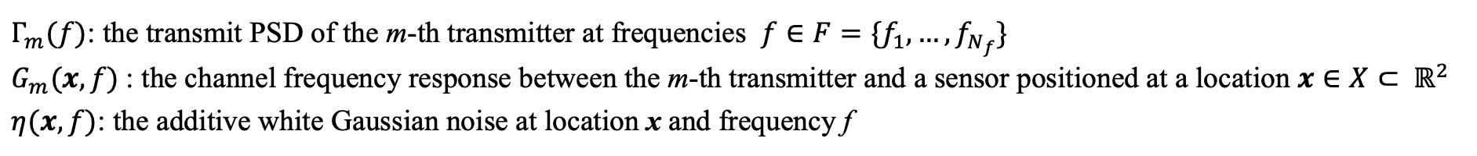
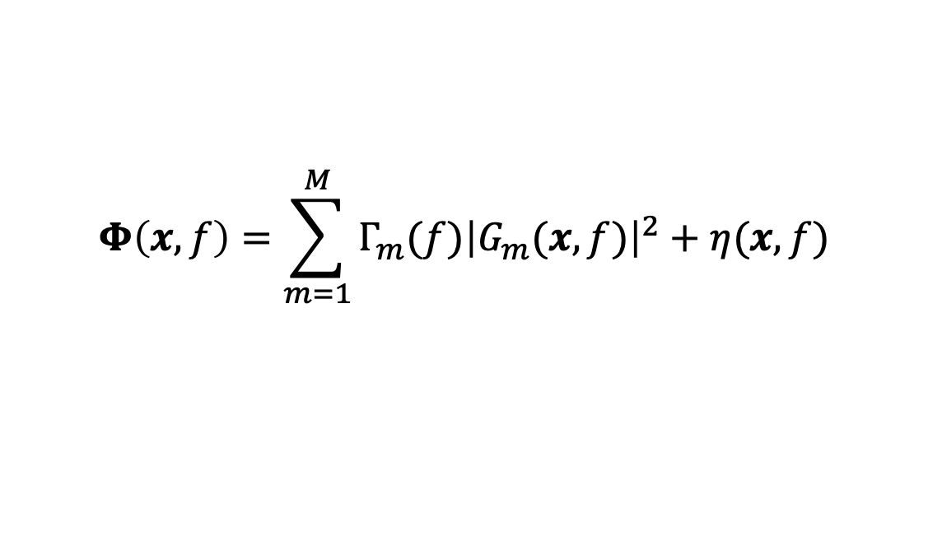
Problem formulation: Spatial Distribution of Received PSD
The received PSD can be expressed as:
$$Φ\left(x,f\right)=\sum_{m=1}^{M}{Γ_{m}(f){\left|G_{m}(x,f)\right|}^{2}}+η(x,f)$$
$Γ_{m}(f)$: the transmit PSD of the m-th transmitter at frequencies $f∈F=\{f_{1}, …,f_{N_{f}}\}$
$G_{m}(x,f)$: the channel frequency response between the m-th transmitter and a sensor positioned at a location $x∈X⊂ ℝ^{2}$
$η(x,f)$: the additive white Gaussian noise at location x and frequency f
F
$$Φ \left(x,F\right)$$
Received PSD
The element of an $N_{x}×N_{y}×N_{f}$ tensor $Φ$
Full-scale RME

Slide 5
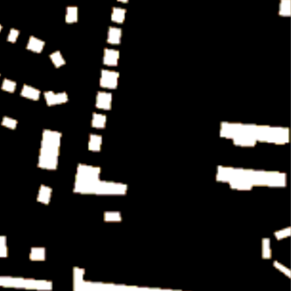
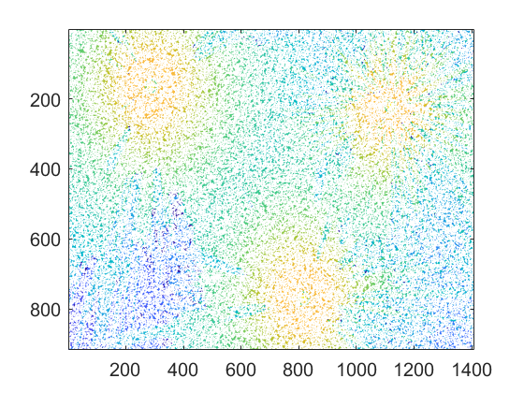

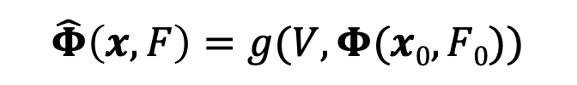
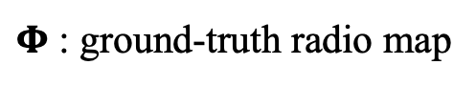
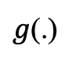
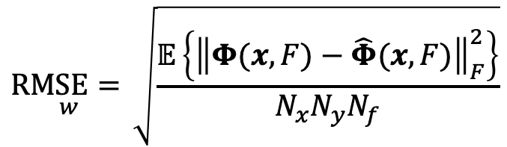
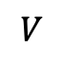
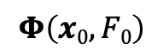

Problem formulation: Radio map estimation (RME)
Learning-based (centralized) RME ^{Romero –Kim’2022}
$$\underset{w}{RMSE=}{\sqrt{\frac{𝔼\left\{{\left\|Φ(x,F)−\hat{Φ}(x,F)\right\|}_{F}^{2}\right\}}{N_{x}N_{y}N_{f}}}}$$
$$\hat{Φ}\left(x,F\right)=g(V,Φ(x0,F0))$$
$Φ$ : ground-truth radio map
$$V$$
$$Φ\left(x0,F0\right)$$
$g$(.)
$$\hat{Φ}\left(x,F\right)$$
Building info
Sparse measurements
Mapping (e.g. DNN)
Full-scale RME
Measurements: sparse samples collected by terminal devices/sensors
No channel information required; whereas ray tracing needs channel models
RUs make partial observations of the global radio map

Slide 6
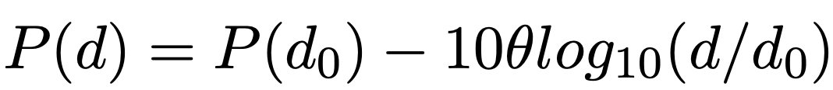
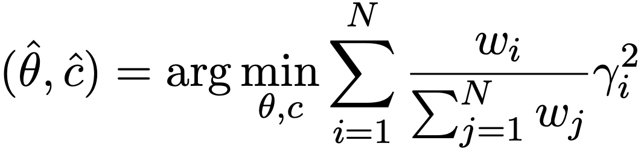
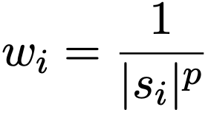
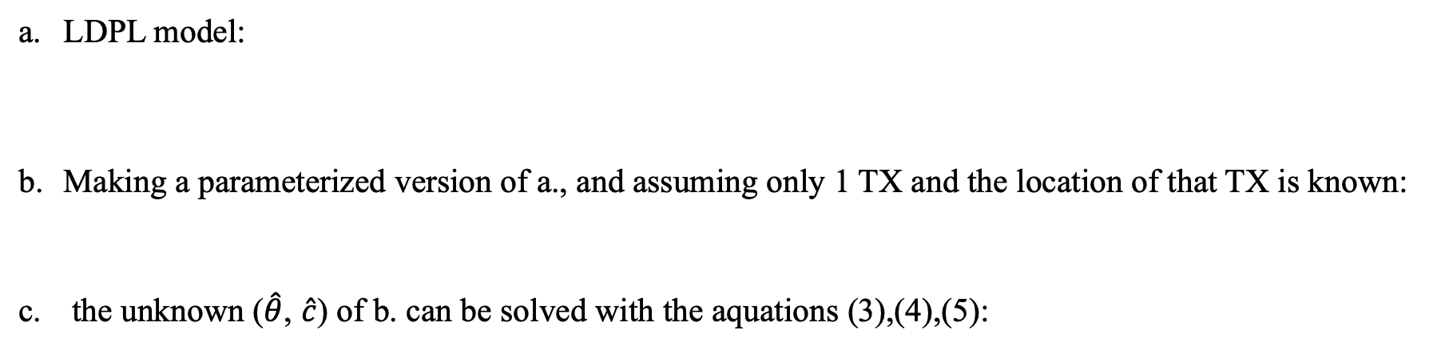
Model-based SP method: LDPL^{[1]}
LDPL ^{[1]}: Using a Log Distance Path Loss Model based Interpolation method
LDPL model:
Making a parameterized version of a., and assuming only 1 TX and the location of that TX is known:
the unknown ($\hat{θ}$, $\hat{c}$) of b. can be solved with the aquations (3),(4),(5):
(1)
(2)
(3)
(4) (5)
where P(d), $θ$, P(d₀) denote an estimated RSS at distance d from TX to point, path loss, observed RSS at reference distance d₀
[1]
M. Lee and D. Han, ”Voronoi tessellation based interpolation method for wi-fi radio map construction,” in IEEE Communications Letters, vol. 16, no. 3, pp. 404-407, Mar. 2012.
Notes:
r_i measures i-th error between observed and pred. w_i is a weighting factor for r_i. let r_i have a different level of importance in the sum.
s_i​ represents the RSS at observed point
Locations with a high RSS will have a smaller weight w_i, making them less influential in the optimization.
The parameter p controls the sensitivity of this weighting. Higher p values would give less weight to locations with strong signals

Slide 7
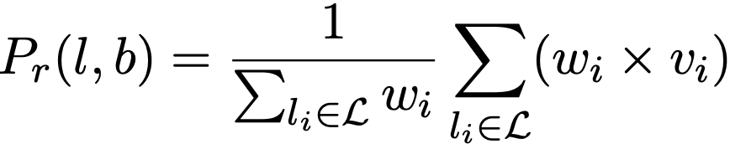
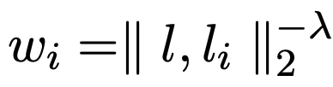
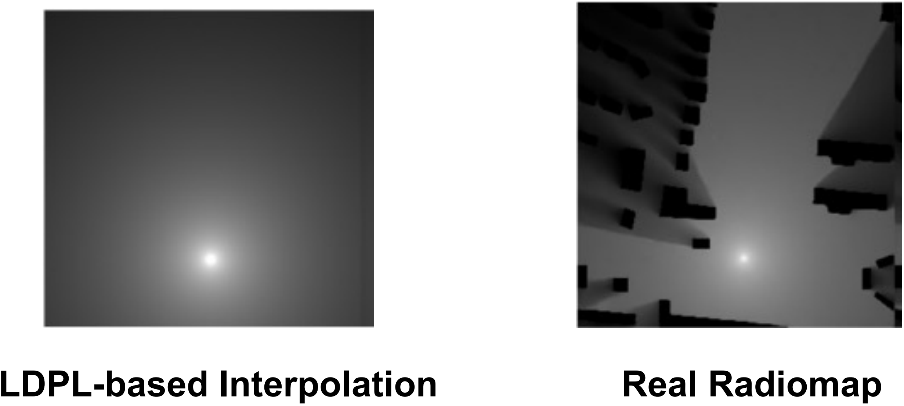
Model-based SP method: IDW^{[2]}
IDW ^{[2]}: Using Inverse Weight Model based Interpolation method
Estimated RSS are calculated by the sum of observed RSS multiplied by a normalized weight :
Weight w_{i} is calculated by Euclidean distance:
(1)
(2)
where l_{i} is the i-th observed point, v_{i} is the observed RSS from TX at the observed point $θ$
where l is the location of estimated point, $λ$ is system parameter (typically =0.01)
Limitation of Model-based SP method:
Not capturing shadowing effects (buildings)
S. -P. Kuo and Y. -C. Tseng, “Discriminant minimization search for largescale rf-based localization systems,” in IEEE Transactions on Mobile Computing, vol. 10, no. 2, pp. 291-304, Feb. 2011.
[2]

Slide 8
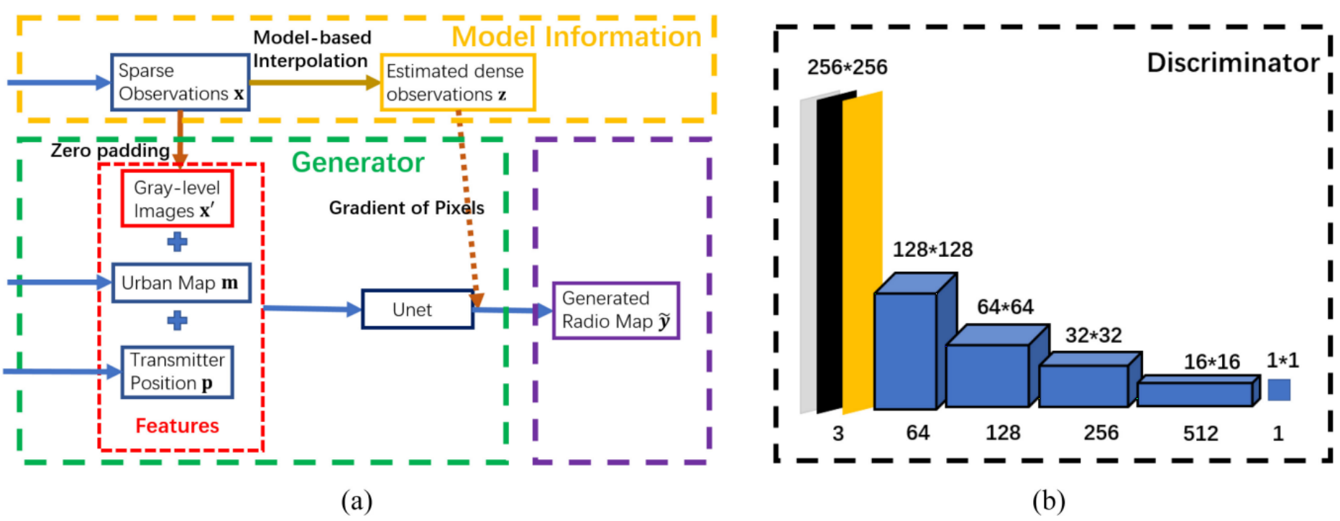
Generative AI with Physics Loss for RME^{[3]}
Unlike Image Recovery
Spectrum coverage follows physical radio propagation principles.
RME-GAN ^{[3]}: Customize the physical loss function of conditional GAN for radiomap estimation
[3]
S. Zhang, A. Wijesinghe, and Z. Ding, “Rme-gan: A learning framework for radio map estimation based on conditional generative adversarial network,” IEEE Internet of Things Journal, vol. 10, no. 20, pp. 18 016–18 027, 2023

Slide 9
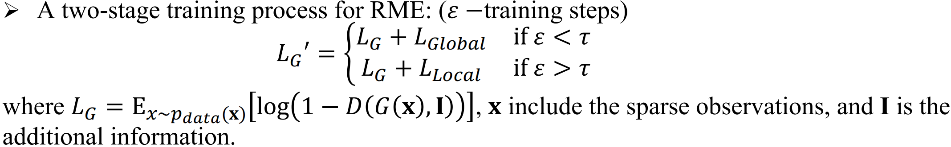
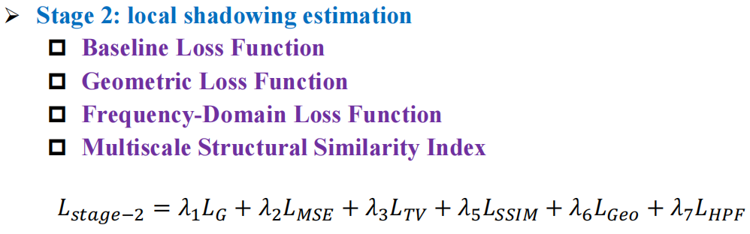
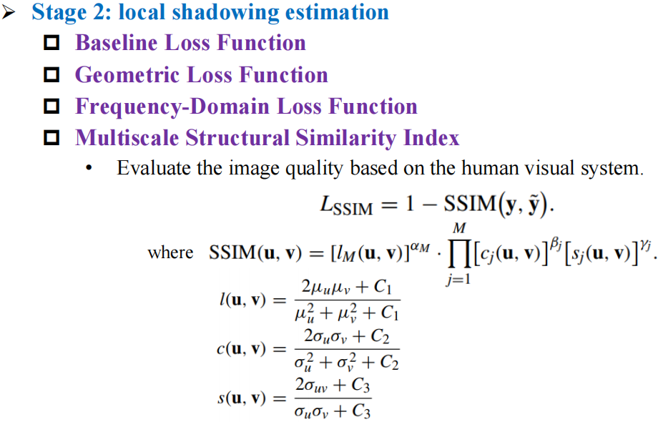
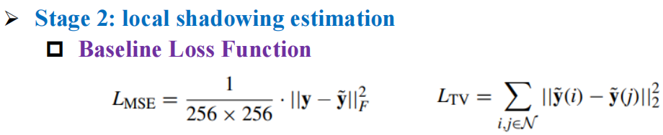
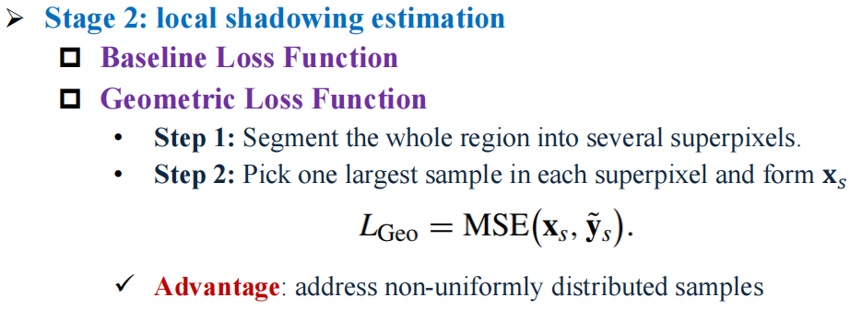
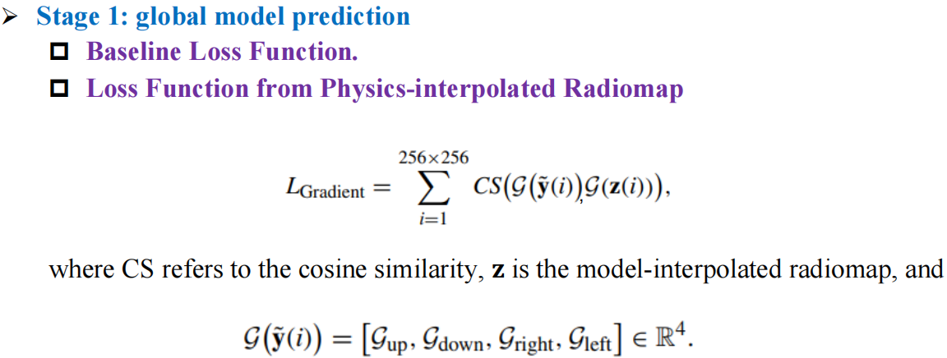
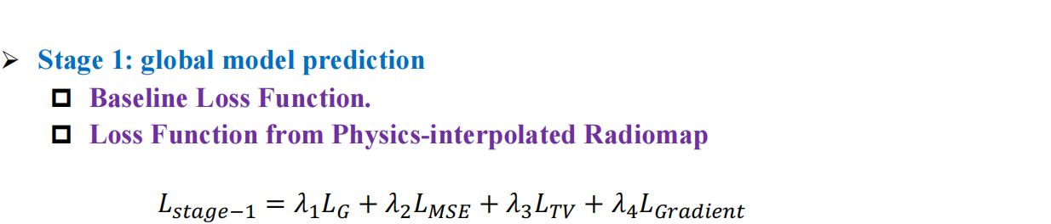
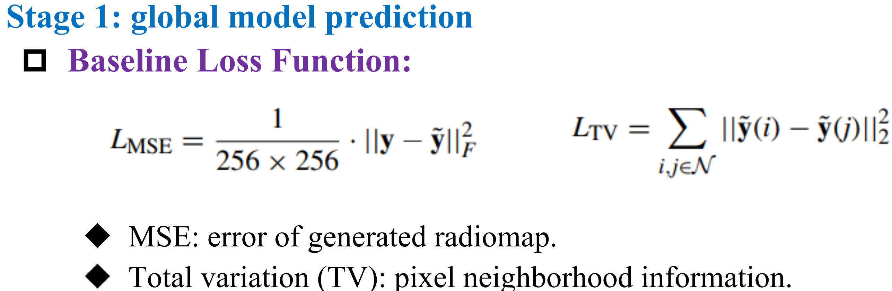
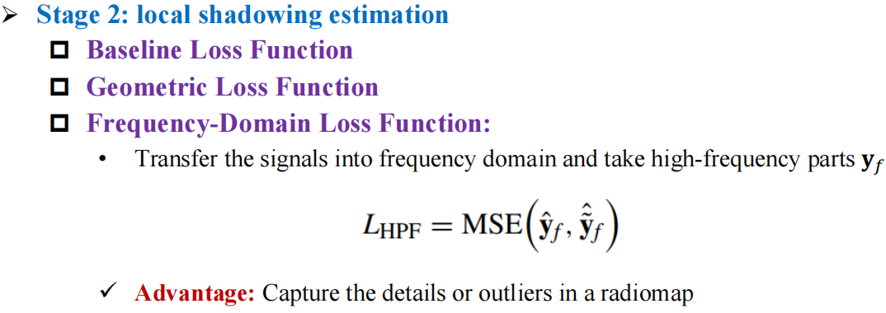
Overall Framework of RME-GAN
[3]
S. Zhang, A. Wijesinghe, and Z. Ding, “Rme-gan: A learning framework for radio map estimation based on conditional generative adversarial network,” IEEE Internet of Things Journal, vol. 10, no. 20, pp. 18 016–18 027, 2023
Notes:
Epsilon
Brightness similarity
Contrast similarity
structural

Slide 10
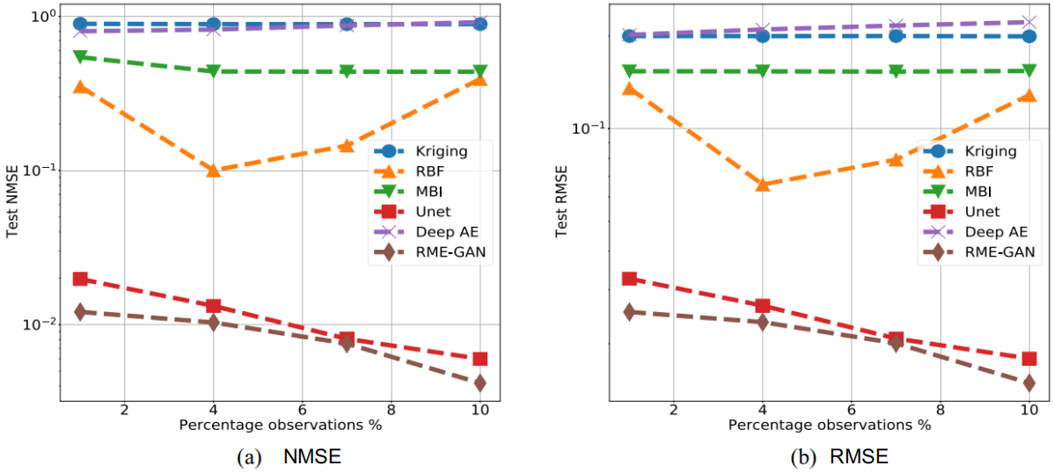
Simulation Results
[3]
S. Zhang, A. Wijesinghe, and Z. Ding, “Rme-gan: A learning framework for radio map estimation based on conditional generative adversarial network,” IEEE Internet of Things Journal, vol. 10, no. 20, pp. 18 016–18 027, 2023

Slide 11
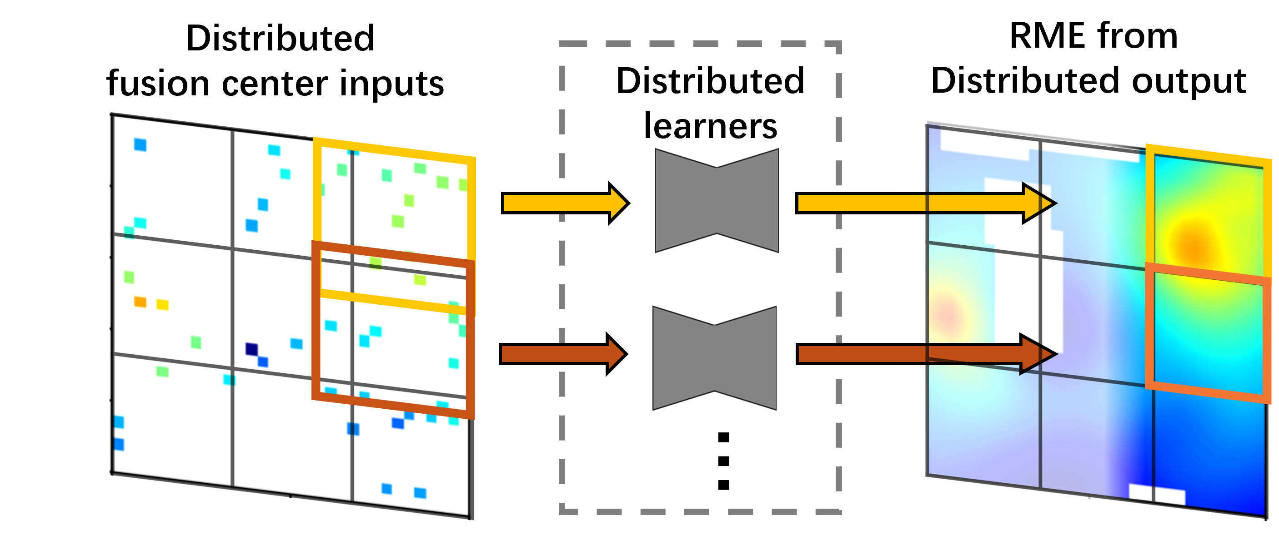
Federated Learning for distributed RME ^{[4]}
Local input:
Local sensor sparse RSS
Sensor mask
City map
Homogeneous local tasks: RME given sparse sensor data and building info.
Allow overlapping between adjacent regions.
Combine trimmed local outputs for global RME.
[4]
Weishan Zhang, Yue Wang, Lingjia Liu, Zhi Tian, “FedRME: Federated Learning for Enhanced Distributed Radiomap Estimation,” in 2024 IEEE 100th Vehicular Technology Conference (VTC2024-fall). IEEE, 2024.
Notes:
In realistic scenarios, a centralized fusion center consumes a huge amount of communication resource in processing raw data and aggregating spectral measurements from all sensor devices, which also raises critical concerns on data privacy leakage

Slide 12
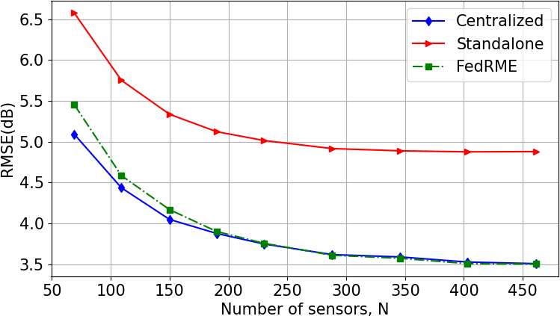
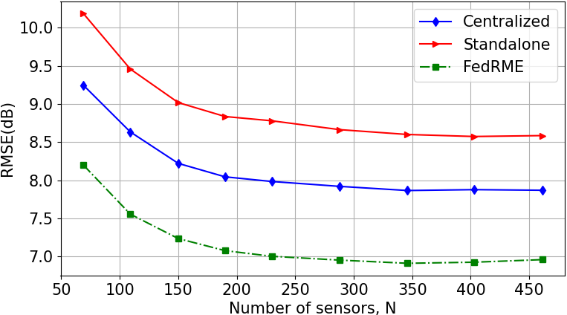
Simulation Results
RMSE vs sensor volume (1000 testing instances)
Trained with sufficient training data (20k training)
Trained with limited training data (1k training)
Comparable RMSE to centralized learning
Outperforming the standalone method.
Apparently outperforms all baselines

Slide 13
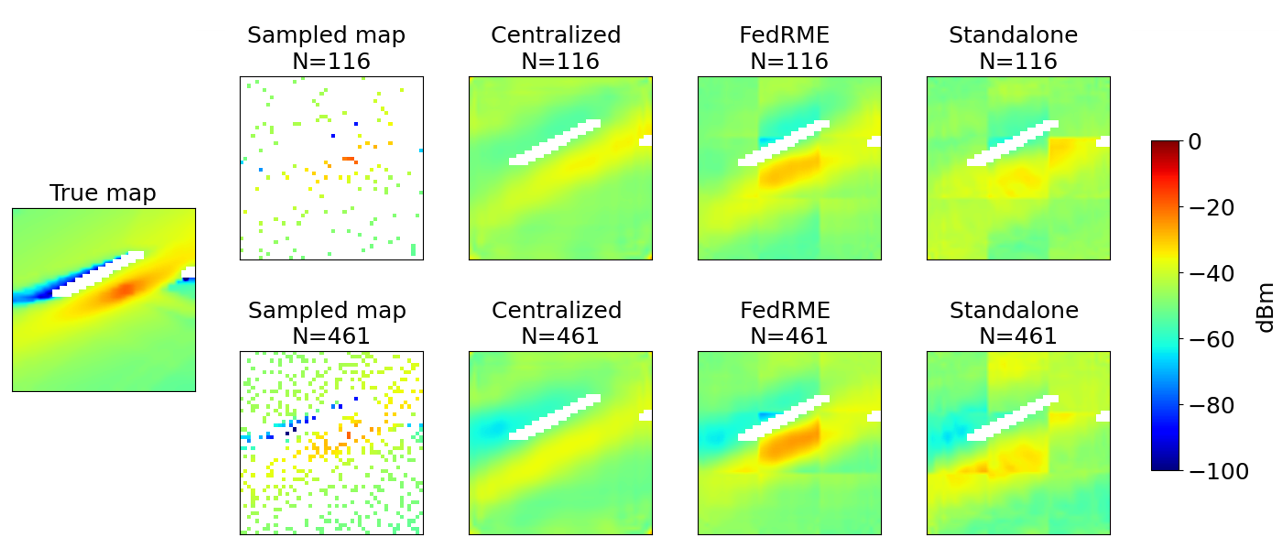
Simulation
Example output of different RME methods (1k training data):
Fewer
sensors
More
sensors
FedRME gives more reasonable estimates, especially around the Tx
Notes:
Due to overfitting, cannot find source
Stdaln:

Slide 14
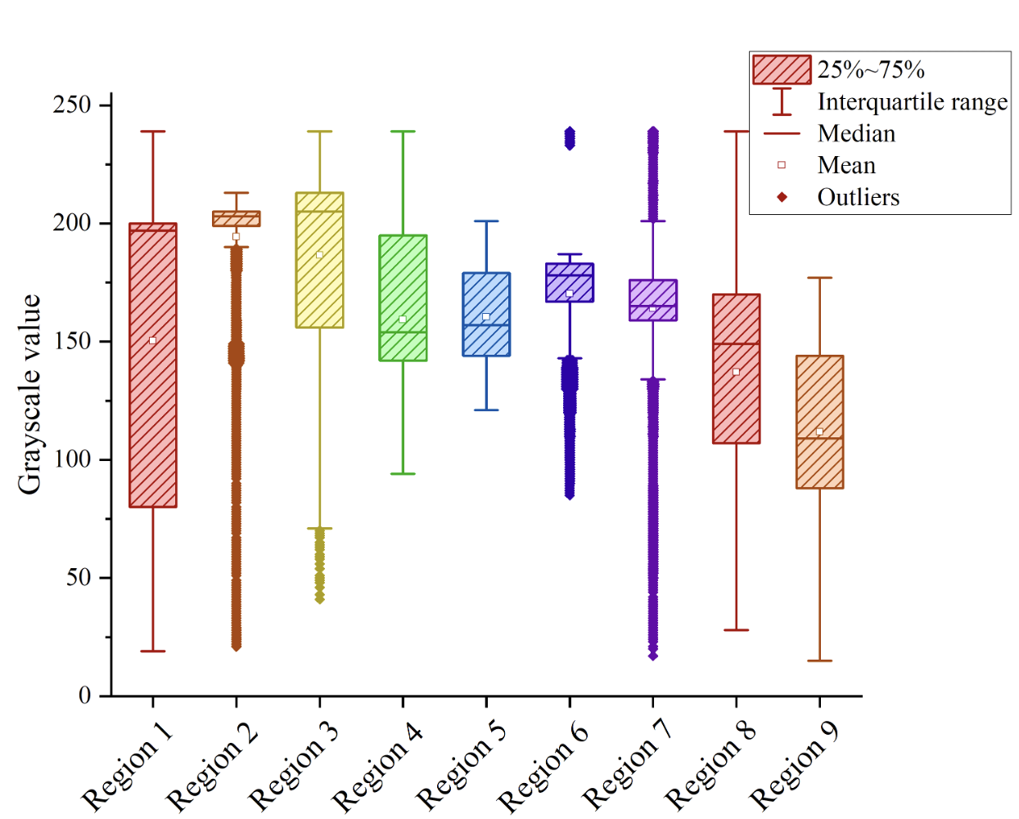
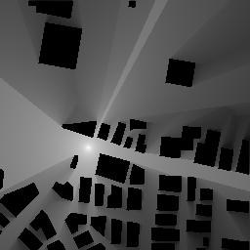
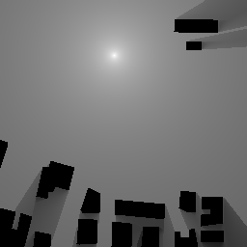
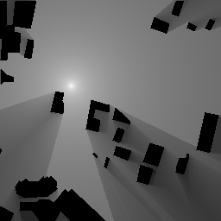
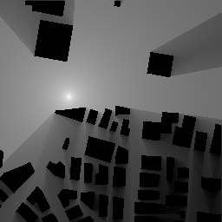
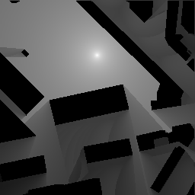
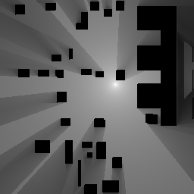
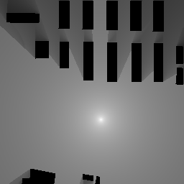
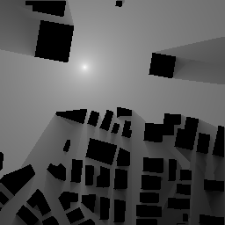

Physics-inspired distributed RME: Challenge
Challenge: Heterogeneous local tasks: RME only given sparse sensor data and TX location.
Notes:
Due to the impact of buildings, the channel condition is inconsistent over space, results in heterogeneous local data/tasks.
There is always a discrepancy across clients.
This is due to the unique building distributions in local environments among clients.

Slide 15
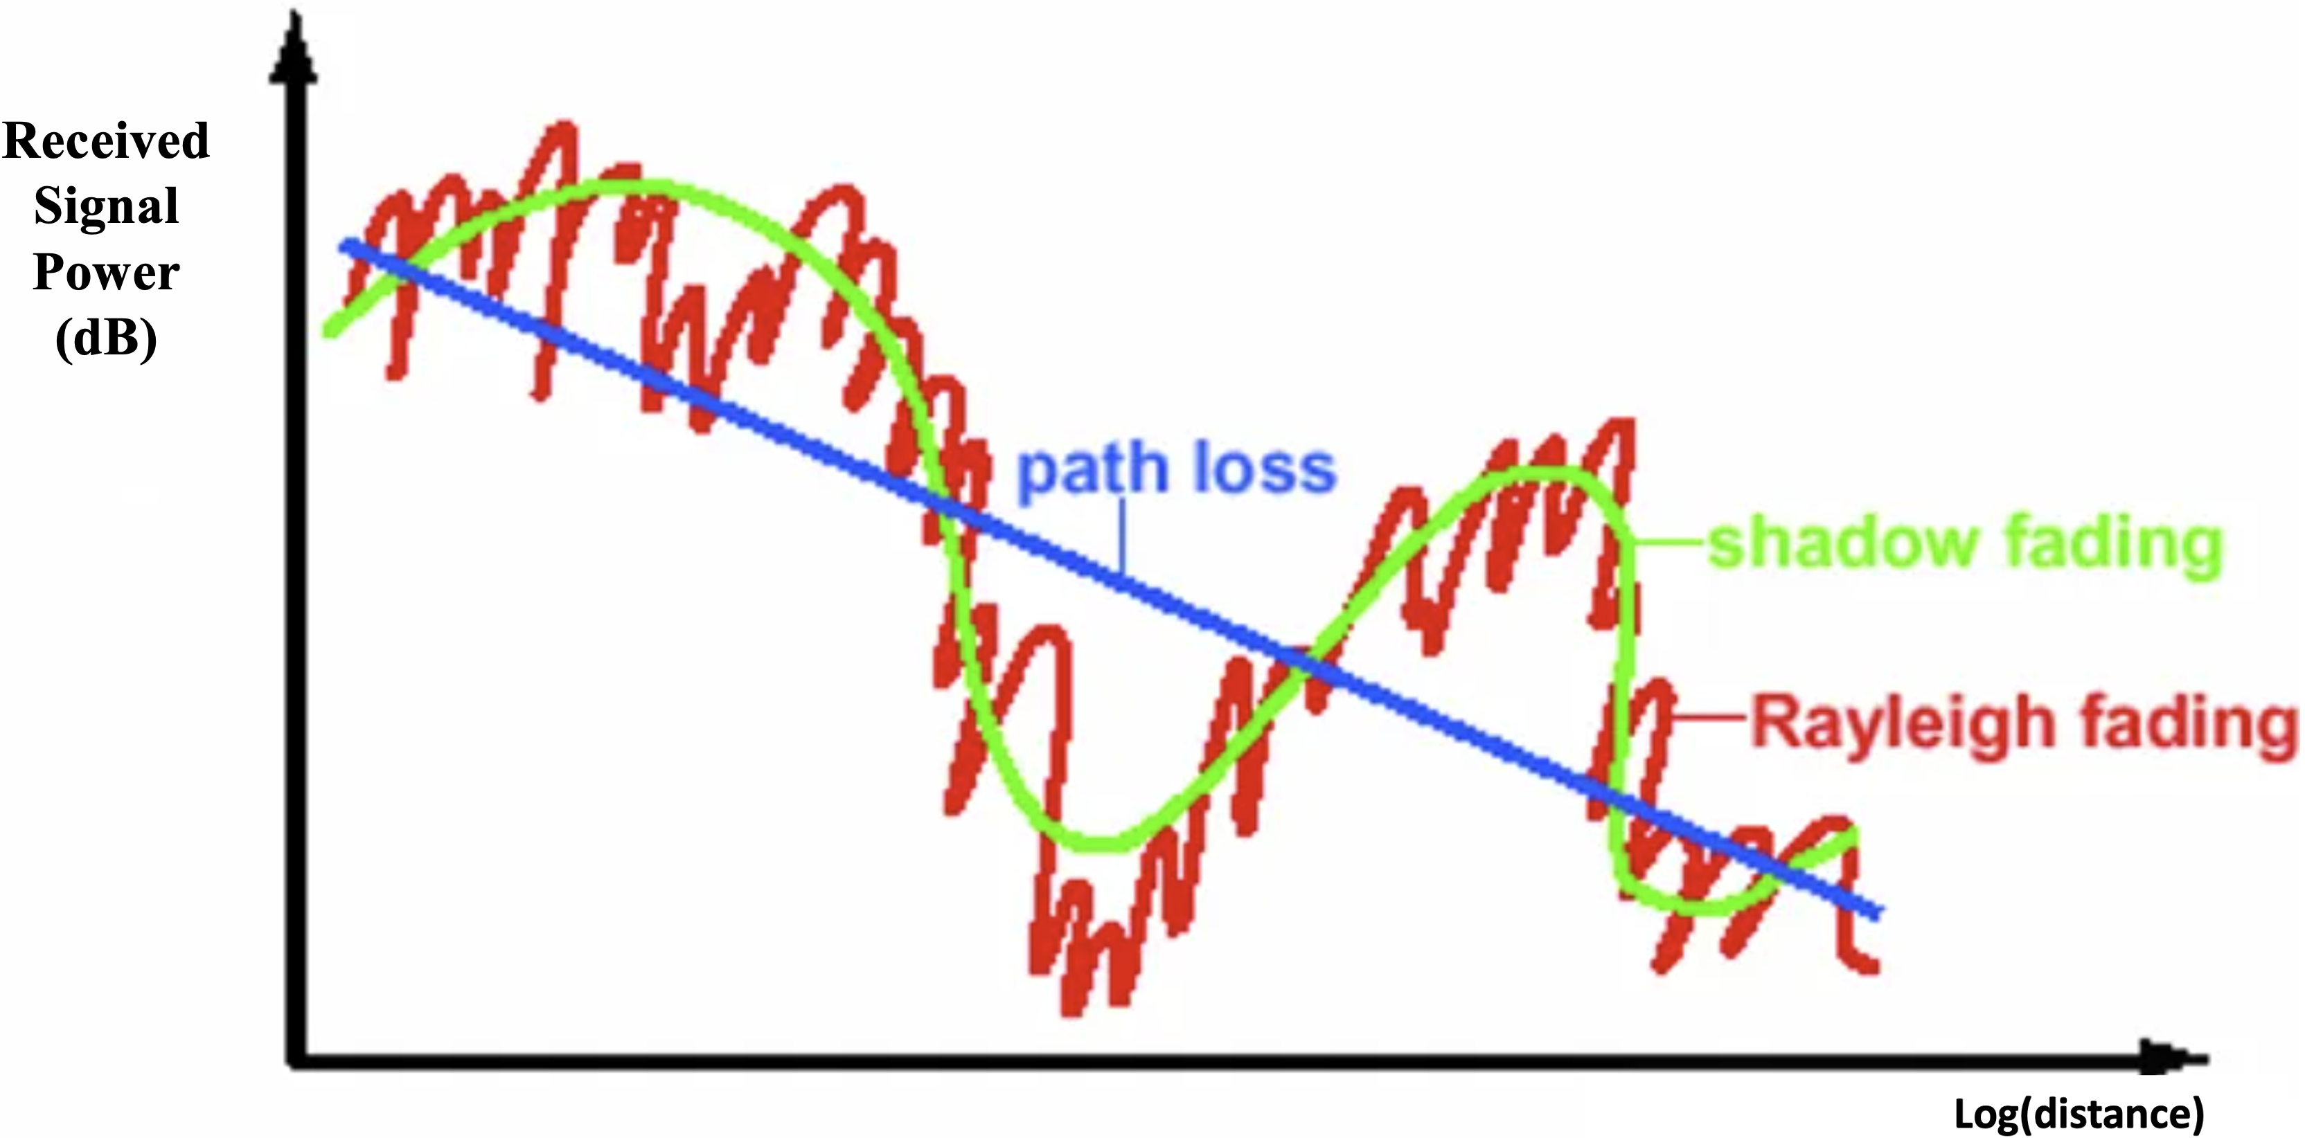
Physics-inspired distributed RME: Motivation
Received Signal Power (dB) =free space path loss + shadow fading + Rayleigh fading
Notes:
To address such model heterogeneity among clients, inspired by the domain knowledge that different wireless channel models hold different propagation properties leading to different impacts on received signal power,

Slide 16
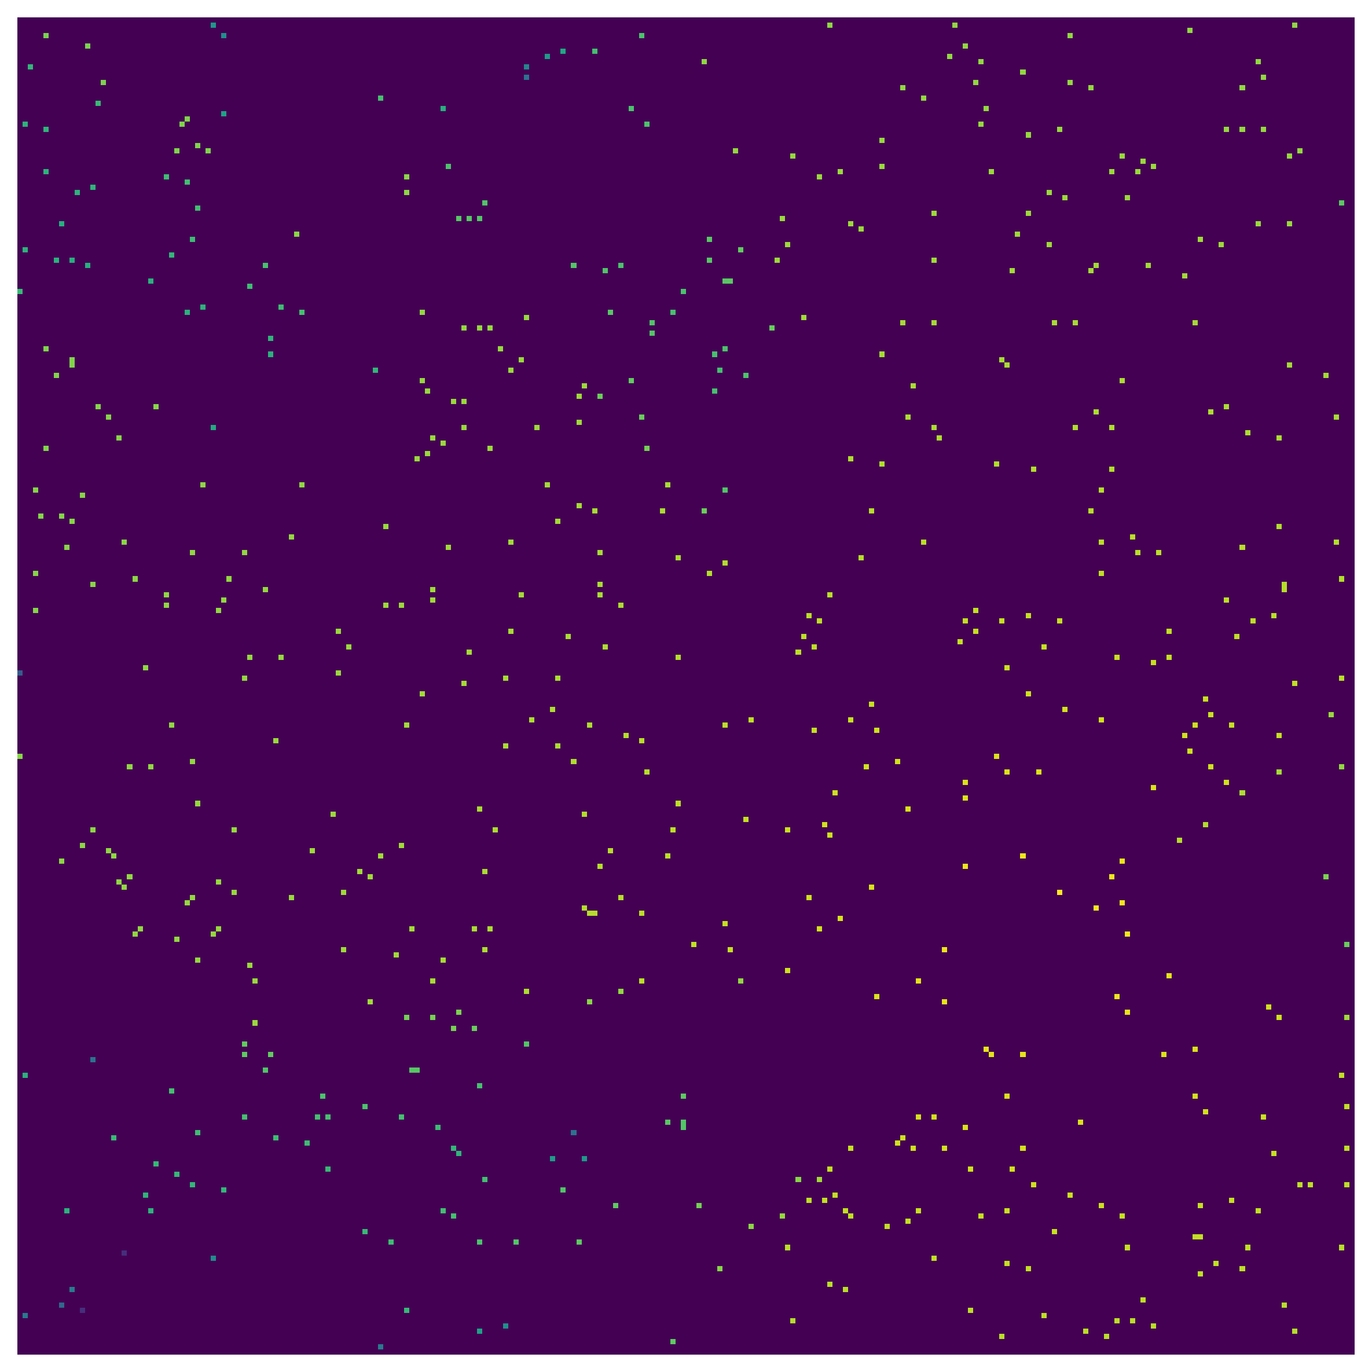
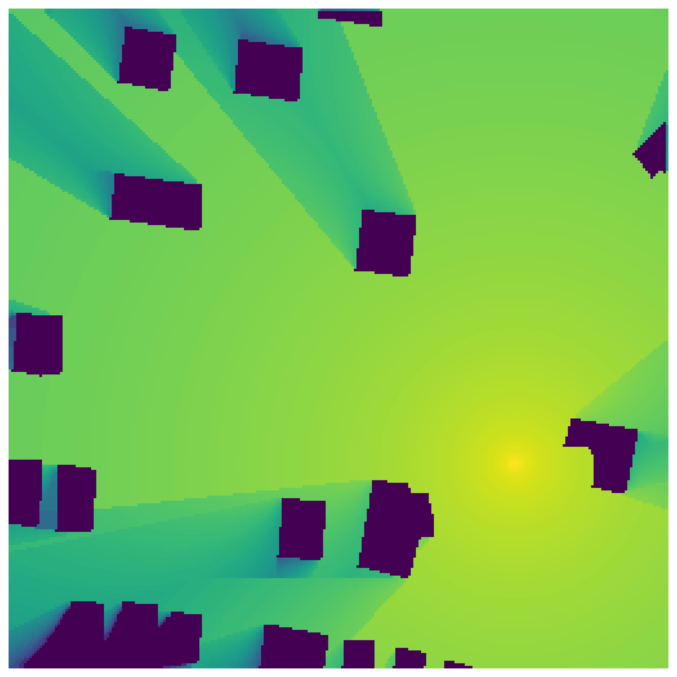





Designing model
Received Signal Power (dB) =free space path loss + shadow fading
Individual part for each client for FL
Common part for each client for FL
$$Φ \left(x0,F0\right)$$
$$G_{com}$$
$$G_{ind}$$
$$TX$$
Client i
Output: Estimated radio map
Input: Measurements, Tx location
Notes:
we decouple the entire deep learning model into different modules.
It allows clients to collaborate in training their common module to capture the pathloss influence, and meanwhile, to train their client specific module individually.

Slide 17














Weighted Constraint Regularization
$$Θ_{g_{com, e}}^{z}$$
$Θ_{g_{com,e}}^{z}$= $avg({{\{Θ}_{g_{com,e}^{s}}^{z}\}}_{s})$
pull
push
$$Θ_{g_{com,e}^{1}}^{z+1}$$
$$Θ_{g_{com,e}^{S}}^{z+1}$$
$$Θ_{g_{com,e}}^{z}$$
$$Θ_{g_{com,e}}^{z}$$
$$Θ_{g_{com}^{s}}^{z, t}$$
Anchor
Positive
…
$$g_{com}^{1}$$
$$g_{ind}^{1}$$
$$g_{com}^{S}$$
$$g_{ind}^{S}$$
Negative
$$Θ_{g_{com}^{1,..,S}}^{z−1}$$
Client 1
Client S

Slide 18


Loss function for common representation: Gradient Smoothness
Getting the gradients for each grid:
$$𝒢\left({\hat{Φ}}_{com}\left(i\right)\right)=\left[𝒢_{left},𝒢_{right},𝒢_{up},𝒢_{down}\right]∈ℝ^{4}$$
Gradient-based loss function:
$$ℒ_{gradient}=\sum_{i=1}^{N_{x}N_{y}}{{CS(𝒢\left({\hat{Φ}}_{com}\left(i\right)\right),𝒢\left(P(i)\right))}^{2}}$$
$$P\left(i\right)=P(i_{a},i_{b})=α−10θ\log_{10}{(\sqrt{{\left(i_{m,a}−i_{a}\right)}^{2}+{\left(i_{m,b}−i_{b}\right)}^{2}})}$$

Slide 19




Loss function for common representation: Weighted constraint regularization
Epoch 1… T
$$Θ$$
Round z-1
Round z
Round z+1
$$ℒ_{con}=\frac{{\left\|Θ_{g_{com}^{s}}^{z,t}−Θ_{g_{com}}^{z}\right\|}_{2}}{\sum_{i=1}^{S}{{\left\|Θ_{g_{com}^{s}}^{z,t}−Θ_{g_{com}^{i}}^{z−1,t}\right\|}_{2}}}$$
$$ℒ=μ_{1}ℒ_{gra}\left(Θ_{g_{com}^{s}}^{z};Φ(x0,F0)\right)$$
$$+ μ_{2}ℒ_{con}\left(Θ_{g_{com}^{s}}^{z};\left\{Θ_{g_{com}^{i}}^{z−1},i∈S\right\};Θ_{g_{com}}^{z};Φ(x0,F0)\right)$$
Notes:
Different wireless channel models exhibit distinct propagation properties, thus to mitigate potential biases in local radio propagation,
We propose this to guide g^s_com in learning common propagation features.

Slide 20


Loss Function for Individual representation
Loss function for recovering individual radio maps:
$$ℒ_{rec}=\frac{1}{N_{x}N_{y}}{\left\|Φ^{s}−{\hat{Φ}}^{s}\right\|}_{2}$$
Where ${\hat{Φ}}^{s}=g_{ind}^{s}\left(g_{com}\left(Φ(x0,F0);Θ_{g_{com}}\right);Θ_{g_{ind}^{s}}\right)$

Slide 21








Dataset: RadiomapSeer^{[4]}
1
2
80
Client 1
…
Client 2
…
…
Client 9
[4]
“OpenStreetMap contributors.” Planet Dump. 2017. [Online]. Available: https://planet.osm.org
Notes:
Cellular network
The radio maps are stored as 2D grids of size 256 × 256 m2, with a spatial resolution of 1m per grid cell
Suppose each client only monitors one region.

Slide 22

Training Cases
Data augmentation
32
49
256
…
49 smaller radio maps of size 64×64
256
The 256×256-size radio map
Three different cases
Case-1: uniformly sample. 12.5% of sparse measurements;
Case-2: a random rate. between 1% and 10% for each client;
Case-3: an unbalanced manner. 1% rate on one half and 10% on the other half.
Notes:
In this way, each client has access to 80 radio maps. Overfitting
To mitigate this issue, we apply data augmentation by dividing each 256×256-size radio map into 49 smaller radio maps of size 64×64, with an overlap of 32 grid cells between adjacent radio maps.

Slide 23

Result: Visualization
The proposed method appear in higher quality and more closely resemble to the true map

Slide 24








Result：Visualization(consistency)
True RM
Learned Common part
Client 7
Client 7
Client 7
Client 7
The work can learn the common parts over clients
Physical meaning
Free space path loss

Slide 25
Next Plan –Schedule
1/17—4/30
Complete the paper and submit it for Journal publication
5/1—5/31
Design RME without TX location and city maps / decentralized learning for distributed learning
6/1—6/30
Writing papers and model parameters tuning
7/1—7/31
Optimize paper script
Complete the paper and submit it for Conf./Journal publication

Slide 26
Next Plan – Algorithm Level
Federated learning ->Decentralized learning RME
Consensus-based collaborations via ADMM
Hierarchical hyper-graph learning based on wireless network topology, devices capability, link resource, and data availability
Compressed sensing and hybrid NN training
Domain knowledge: statistics, basis, structures
Sparse representation and dictionary learning
unknown coefficients
known basis
1
1
1
1
1
1
1
1
1
1
1
1
1
1
1
1

Slide 27
Thank You!

